Slide 1
Ethics in Sciences
Enter one word in chat window that comes to your mind when you hear this topic

Slide 2
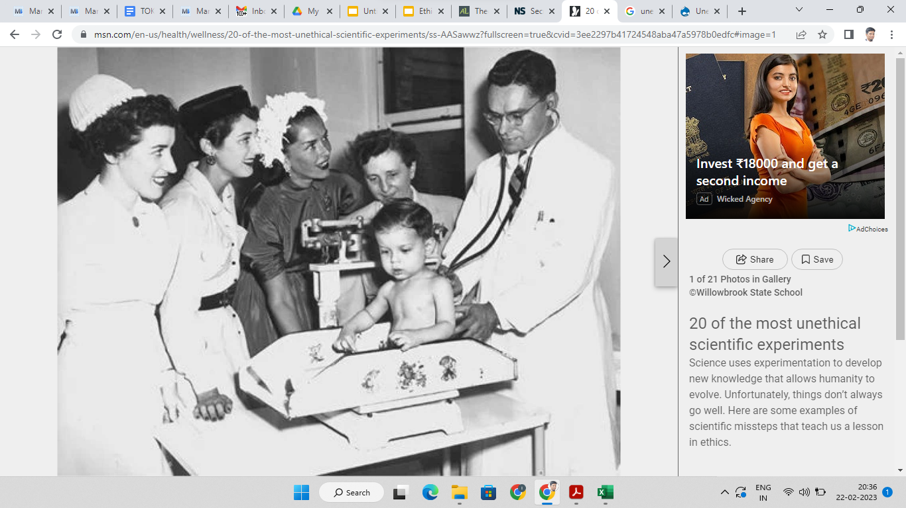
20 of the most unethical scientific experiments - MSN.com

Slide 3
Questions to ponder
Why is this article only shows experiments on humans as the most unethical experiments?
Are there no studies or experiments in subjects like physics and chemistry that are unethical?
Are there more ethical concerns in human sciences compared to natural sciences?
Write a quick response in chat.

Slide 4
TOK Concept - Responsibility
Questions about the responsibility of scientist:
Responsibility of the types questions they investigate
Responsibility for the method of investigation
Responsibility for the use of the knowledge produced
Responsibility for quality of knowledge produced
Responsibility of taking the contributions of others seriously while publishing the report.
Can you think of any other responsibilities? Are these responsibilities same in both natural and human sciences.

Slide 5
What are your responsibilities as a knower?
Connection with Core Theme - Knowledge and knower
What moral obligations to act or not act do we have if our knowledge is tentative, incomplete or uncertain? (More so in human sciences)
Do the natural sciences provide us with good examples of people who approach knowledge in a rigorous and responsible way? If yes, should you try to imitate the methods of natural science in all our knowledge acquisition?

Slide 6
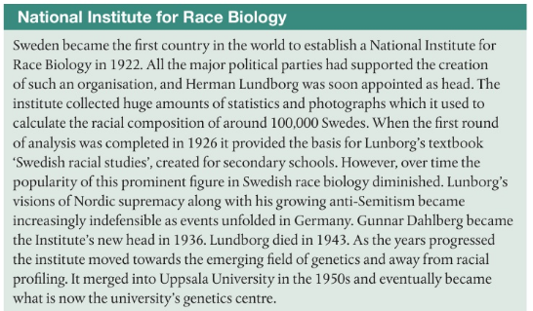
Responsibilities for the questions asked?
What should we not ask in different scientific disciplines?
Example: Race Biology
Why might asking questions about racial biology be unethical?
What responsibilities we have towards knowledge gathered under past programme such as these?
Read more about this 100 years in the shadow of the Institute for Racial Biology - The Guild
Theme: Knowledge and Politics “risk of science being kidnapped when it serves political ends – and to the way in which science can sometimes kidnap itself.”

Slide 7
Responsibility of methods and used
IB Students must abide by the IB ethical code of practice which regulates the use of animals in schools.
Animal-experimentation_policy.pdf
Why the use of animals should be restricted in scientific research?
Are there situations where such use of animals for experimentation be allowed?
Are situations where animal experimentation is ethically required?
Most of us from our school days have performed animal dissection, now it is not allowed, have our values changed?
On what grounds can you decide if animal experimentation is allowed, prohibited or required?
Are there additional concerns when we use humans for experiments?

Slide 8
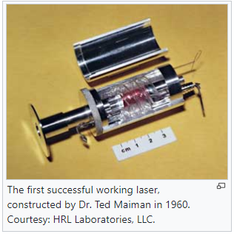
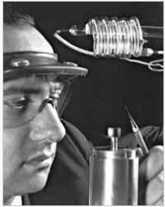
Responsibility for how knowledge is used
How can scientists be held responsible for the use of their discoveries and inventions. Many a times scientists may not be aware of the uses their scientific inventions would have in the real world.
Dr. Ted Maiman was not aware that his invention of working laser would be one day used in so many different areas including missile navigation, weapons etc.
But many scientists specially who are working with military are aware of what their work will be used for.
Scientists working with big pharmaceutical companies are aware that their discoveries which have potential to save millions of lives will be exploited for commercial purposes and would be sold a very high rates.
Dr. Theodore “Ted” Maiman

Slide 9
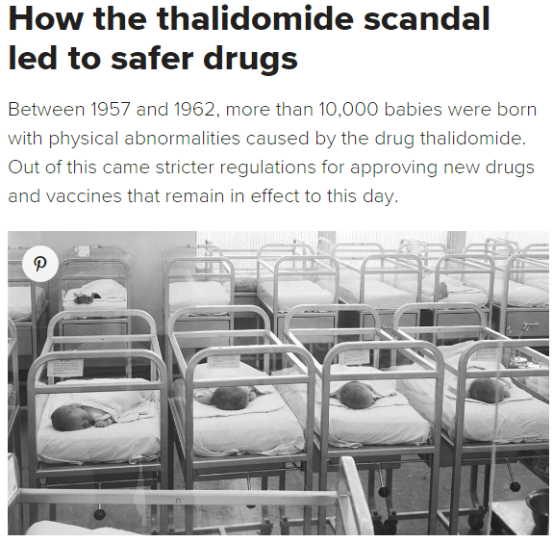
Responsibility for Quality of Knowledge
Scientists are responsible for the quality of knowledge such as accuracy and reliability. Unlike other fields there might be a lot at stake if the knowledge is not reliable.
The science museum in London described Thalidomide as the darkest episode in pharmaceutical research.
Are you aware of any other cases where things have gone wrong, either due to financial or political pressure? Where does the responsibility lies in this case?
Links with the concept of Power and Optional Theme Knowledge and Politics
How medical research changed after thalidomide

Slide 10
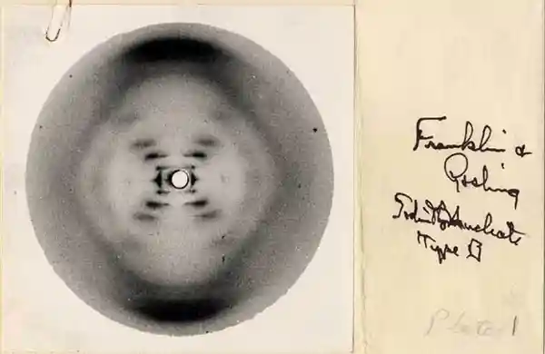
Responsibility of taking seriously the contribution of others
Responsibility of taking the knowledge of others seriously, and attributing their contributions. Scientists often:
Remove co-workers from historical records of their research to take full credit or because they are women
Discovery of Pulsars in 1967 contributions of Jocelyn Bell were ignored Hewish and his colleague Martin Ryle were awarded the Nobel Prize in Physics in 1974 for the pulsar discovery, while Bell Burnell did not get recognition.
Another example is discovery of structure of DNA where male scientists mention the work by Rosalind Franklin - called the “The Dark Lady of DNA”
Do you know any other examples:
Connection with Core Theme: Knowledge and the Knower
Do you also do these kind of things? When you are not attributing the work of others in your assignments? By not giving proper in-text citations and referencing?

Slide 11
Knowledge Framework - Ethics
Natural Sciences
Is science, or should it be, value-free?
Should scientific research be subject to ethical constraints or is the pursuit of all scientific knowledge intrinsically worthwhile?
Do we tend to exaggerate the objectivity of scientific facts and the subjectivity of moral values?
In what ways have developments in science challenged long-held ethical values? Can moral disagreements be resolved with reference to empirical evidence?
Do human rights exist in the same way that the laws of gravity exist?
Do scientists or the societies in which scientists operate exert a greaterinfluence on what is ethically acceptable in this area of knowledge?

Slide 12
Ethics in your Group 4 and Group 3 Subjects
Find out ethical guidelines
Find example of ethical issues and responsibilities
Find examples of ethical breaches
Discuss with your teacher about ethics in the subject

Slide 13
Ethics in Human Sciences
We discussed the following in our last class mostly with respect to Natural Sciences.
Responsibility of the types questions they investigate
Responsibility for the method of investigation
Responsibility for the use of the knowledge produced
Responsibility for quality of knowledge produced
Responsibility of taking the contributions of others seriously while publishing the report.
How are these responsibilities different in human sciences? Are there more or less responsibilities in human sciences compared to Natural Sciences?
How is study of humans different from study of natural objects and animals?

Slide 14
Use of humans in scientific research and experimentation
IBDP Psychology Guide - Ethical Guidelines.pdf
Some Famous experiments. Do they break any of the guidelines given here:
Jane Elliot - Blue eye/brown eye experiment
Hawthorne Work Experiment
Stanley Milgram Experiment
Sherif: Robbers Cave Experiment
Zimbardo et al.: Stanford Prison Experiment
David Reimer case
Asch Conformity experiment
Watsons: Little Albert experiment

Slide 15
What about other human sciences?
What kinds of ethical codes or guideline might by present in other human sciences?
Economics
Geography (is it human science)
Business Management

Slide 16
Knowledge Framework - Ethics
Human Sciences
To what extent are the methods used in the human sciences limited by the ethical considerations involved in studying human beings?
Do researchers have different ethical responsibilities when they are working with human subjects compared to when they are working with animals?
What are the moral implications of possessing knowledge about human behaviour?
Should key events in the historical development of the human sciences always be judged by the standards of their time?
What values determine what counts as legitimate inquiry in the human sciences? Can knowledge be divorced from the values embedded in the process of creating it?
Is the role of the human scientist only to describe what the case is or also to make judgements about what should be the case?

